Slide 1

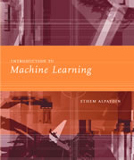
Introduction to Data Science
Lecture Slides for
By Dr. Luc E. Ngend

Slide 2
What is Data Science (DS)?
Data science combines data mining, artificial intelligence (AI), machine learning, maths and statistics, and specialized programming to discover hidden patterns (knowledge) in an organization’s data (Big data). This knowledge is often used to guide decision making and strategic planning in businesses.
By Dr. Luc Ngend

Slide 3
Data Science Explained in 5 Minutes
Please watch the video below:
https://www.youtube.com/watch?v=X3paOmcrTjQ
By Dr. Luc Ngend

Slide 4
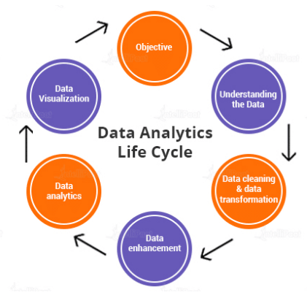
Data Science Lifecycle
By Dr. Luc Ngend

Slide 5
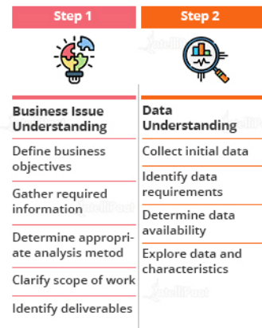
Data Science Lifecycle
By Dr. Luc Ngend

Slide 6
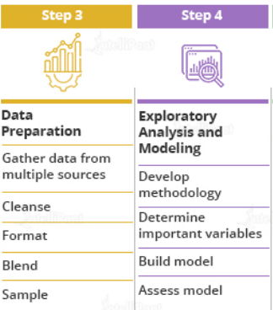
Data Science Lifecycle
By Dr. Luc Ngend

Slide 7
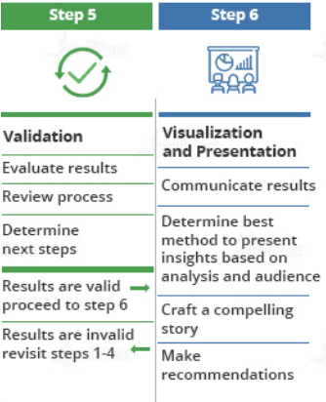
Data Science Lifecycle
By Dr. Luc Ngend

Slide 8
What is a Data Scientist?
Data scientists are among the most recent analytical data professionals who have the technical ability to handle complicated issues as well as the desire to investigate what questions need to be answered. They're a mix of mathematicians, computer scientists, and trend forecasters. They're also in high demand and well-paid because they work in both the business and IT sectors.
By Dr. Luc Ngend

Slide 9
What is a Data Scientist?
On a daily basis, a data scientist may do the following tasks:
Discover patterns and trends in datasets to get insights.
Create forecasting algorithms and data models.
Improve the quality of data or product offerings by utilizing machine learning techniques.
Distribute suggestions to other teams and top management.
In data analysis, use data tools such as R, SAS, Python, or SQL.
Top the field of data science innovations
By Dr. Luc Ngend

Slide 10
Use of Data Science
Data science may detect patterns in seemingly unstructured or unconnected data, allowing conclusions and predictions to be made.
Tech businesses that acquire user data can utilize strategies to transform that data into valuable or profitable information.
By Dr. Luc Ngend

Slide 11
Use of Data Science
Data Science has also made inroads into the transportation industry, such as with driverless cars. It is simple to lower the number of accidents with the use of driverless cars. For example, with driverless cars, training data is supplied to the algorithm, and the data is examined using data Science approaches, such as the speed limit on the highway, busy streets, etc.
Data Science applications provide a better level of therapeutic customisation through genetics and genomics research.
By Dr. Luc Ngend

Slide 12
Applications of Data Science
1. Healthcare
Healthcare companies are using data science to build sophisticated medical instruments to detect and cure diseases.
2. Gaming
Video and computer games are now being created with the help of data science and that has taken the gaming experience to the next level.
3. Image Recognition
Identifying patterns in images and detecting objects in an image is one of the most popular data science applications.
By Dr. Luc Ngend

Slide 13
Applications of Data Science
4. Recommendation Systems
Netflix and Amazon give movie and product recommendations based on what you like to watch, purchase, or browse on their platforms.
5. Logistics
Data Science is used by logistics companies to optimize routes to ensure faster delivery of products and increase operational efficiency.
6. Fraud Detection
Banking and financial institutions use data science and related algorithms to detect fraudulent transactions.
By Dr. Luc Ngend

Slide 14
Applications of Data Science
8. Speech recognition
Speech recognition is dominated by data science techniques. We may see the excellent work of these algorithms in our daily lives. Have you ever needed the help of a virtual speech assistant like Google Assistant, Alexa, or Siri? Well, its voice recognition technology is operating behind the scenes, attempting to interpret and evaluate your words and delivering useful results from your use.
By Dr. Luc Ngend

Slide 15
Applications of Data Science
9. Targeted Advertising
If you thought Search was the most essential data science use, consider this: the whole digital marketing spectrum. From display banners on various websites to digital billboards at airports, data science algorithms are utilized to identify almost anything. This is why digital advertisements have a far higher CTR (Call-Through Rate) than traditional marketing. They can be customized based on a user's prior behavior. That is why you may see adverts for Data Science Training Programs while another person sees an advertisement for clothes in the same region at the same time
By Dr. Luc Ngend

Slide 16
Examples of Data Science
Law Enforcement: In this scenario, data science is used to help police in Belgium to better understand where and when to deploy personnel to prevent crime. With only limited resources and a large area to cover data science used dashboards and reports to increase the officers’ situational awareness, allowing a police force that’s spread thin to maintain order and anticipate criminal activity.
By Dr. Luc Ngend

Slide 17
Examples of Data Science
Pandemic Fighting: The state of Rhode Island wanted to reopen schools, but was naturally cautious, considering the ongoing COVID-19 pandemic. The state used data science to expedite case investigations and contact tracing, enabling a small staff to handle an overwhelming number of concerned calls from citizens. This information helped the state set up a call center and coordinate preventative measures
By Dr. Luc Ngend

Slide 18
Examples of Data Science
Driverless Vehicles: Lunewave, a sensor manufacturing company, was looking for a way to make sensor technology more cost-effective and accurate. They turned to data science and machine learning to train their sensors to be safer and more reliable, as well as using data to improve their 3D-printed sensor manufacturing process.
By Dr. Luc Ngend

Slide 19
Examples of Data Science
Entertainment: Data science enables streaming services to follow and evaluate what consumers view, which aids in the creation of new TV series and films. Data-driven algorithms are also utilized to provide tailored suggestions based on the watching history of a user.
Finance: Banks and credit card firms mine and analyse data in order to detect fraudulent activities, manage financial risks on loans and credit lines, and assess client portfolios in order to uncover upselling possibilities.
By Dr. Luc Ngend

Slide 20
Examples of Data Science
Manufacturing: Data science applications in manufacturing include supply chain management and distribution optimization, as well as predictive maintenance to anticipate probable equipment faults in facilities before they occur.
Healthcare: Machine learning models and other data science components are used by hospitals and other healthcare providers to automate X-ray analysis and assist doctors in diagnosing illnesses and planning treatments based on previous patient outcomes
By Dr. Luc Ngend

Slide 21
Examples of Data Science
Retail: Retailers evaluate client behavior and purchasing trends in order to provide individualized product suggestions as well as targeted advertising, marketing, and promotions. Data science also assists them in managing product inventories and supply chains in order to keep items in stock
By Dr. Luc Ngend

Slide 22
What is Machine Learning?
Machine learning is a part of artificial intelligence and growing technology that enables machines to learn from past data and perform a given task automatically.
By Dr. Luc Ngend

Slide 23
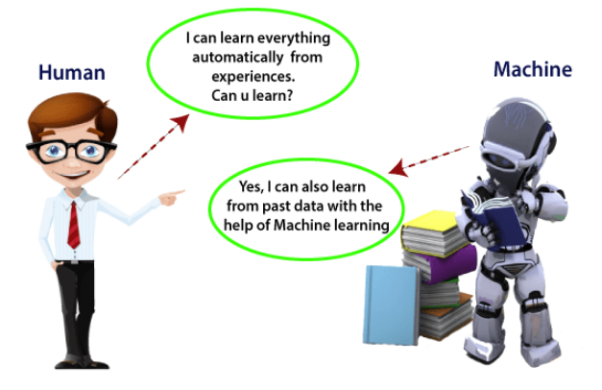
What is Machine Learning?
By Dr. Luc Ngend

Slide 24
How does Machine Learning Work?
The working of machine learning models can be understood by the example of identifying the image of a cat or dog. To identify this, the ML model takes images of both cat and dog as input, extracts the different features of images such as shape, height, nose, eyes, etc., applies the classification algorithm, and predicts the output.
Consider the below image:
By Dr. Luc Ngend

Slide 25
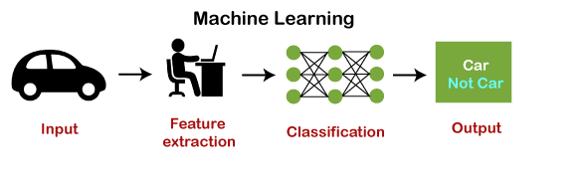
How does Machine Learning Work?
By Dr. Luc Ngend

Slide 26
ML Algorithms
Some useful ML algorithms are:
  Decision Tree algorithm
  Naïve Bayes
  Random Forest
  K-means clustering
  KNN algorithm
  Apriori Algorithm, etc.
By Dr. Luc Ngend

Slide 27
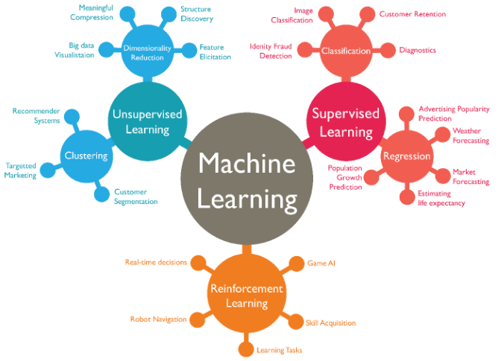
Components of Machine Learning
By Dr. Luc Ngend

Slide 28
Machine Learning in the Nutshell
Please watch the video below:
https://www.youtube.com/watch?v=ukzFI9rgwfU
By Dr. Luc Ngend

Slide 29
Data Mining vs. Machine Learning
Data mining is considered the process of extracting useful information (knowledge) from a vast amount of data (Big data). It’s used to discover new, accurate, and useful patterns in the data, looking for meaning and relevant information for the organization or individual who needs it. It’s a tool used by humans.
Machine Learning on the other hand is the design, study, and development of algorithms that permit machines to learn without human intervention. It’s a tool to make machines smarter, eliminating the human element (but not eliminating humans themselves; that would be wrong).
By Dr. Luc Ngend

Slide 30
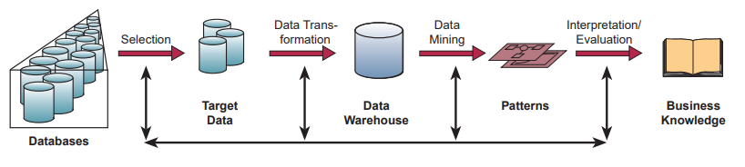
Data Mining vs. Machine Learning
By Dr. Luc Ngend

Slide 31
Machine Learning vs. Deep Learning
Deep Learning is the subset of machine learning or can be said as a special kind of machine learning. It works technically in the same way as machine learning does, but with different capabilities and approaches. It is inspired by the functionality of human brain cells, which are called neurons, and leads to the concept of artificial neural networks. It is also called a deep neural network or deep neural learning.
By Dr. Luc Ngend

Slide 32
Machine Learning vs. Deep Learning
In deep learning, a computer model learns to perform classification tasks directly from images, text, or sound. Deep learning models can achieve state-of-the-art accuracy, sometimes exceeding human-level performance. Models are trained by using a large set of labeled data and neural network architectures that contain many layers.
By Dr. Luc Ngend

Slide 33
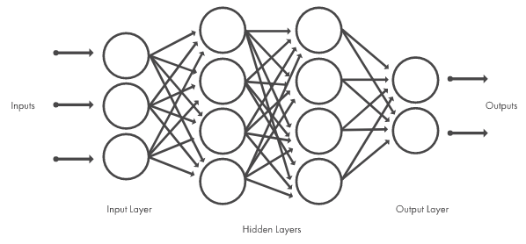
Machine Learning vs. Deep Learning
Deep learning models are trained by using large sets of labeled data and neural network architectures that learn features directly from the data without the need for manual feature extraction.
By Dr. Luc Ngend

Slide 34
Machine Learning vs. Deep Learning
In deep learning, models use different layers to learn and discover insights from the data.
Some popular applications of deep learning are self-driving cars, language translation, natural language processing, etc.
Some popular deep learning models are:
  Convolutional Neural Network
  Recurrent Neural Network
  Auto encoders
  Classic Neural Networks, etc.
By Dr. Luc Ngend

Slide 35
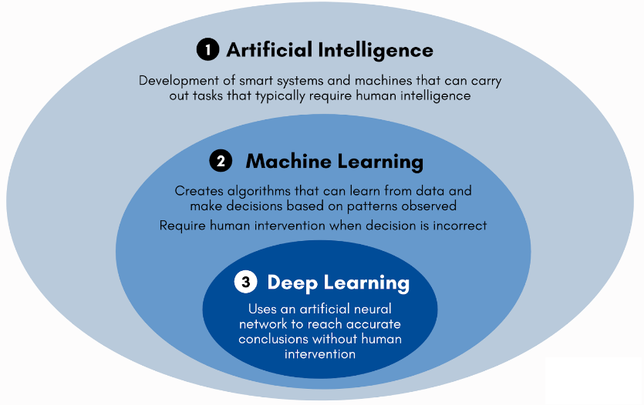
Machine Learning vs. Deep Learning
By Dr. Luc Ngend

Slide 36
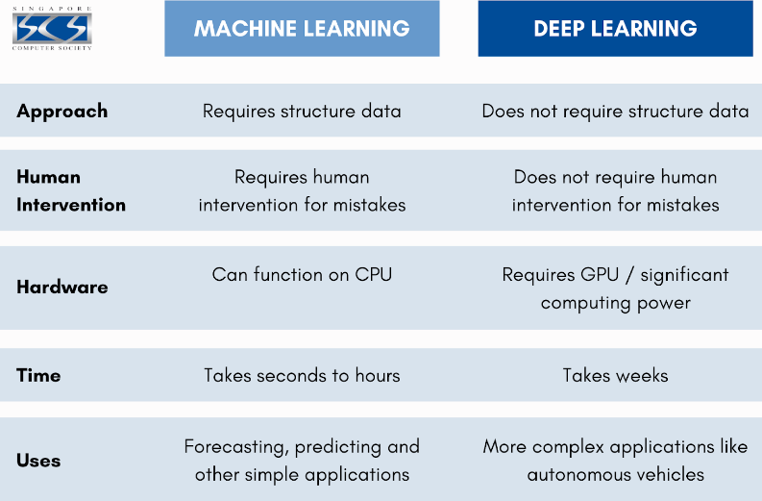
Machine Learning vs. Deep Learning
By Dr. Luc Ngend

Slide 37
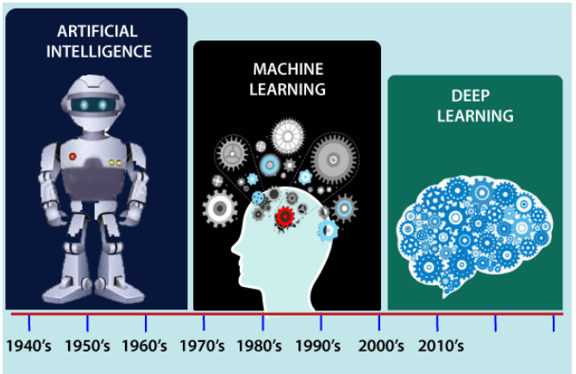
Machine Learning vs. Deep Learning
By Dr. Luc Ngend

Slide 38
How Deep Learning Works?
We can understand the working of deep learning with the same example of identifying cat vs. dog. The deep learning model takes the images as the input and feed it directly to the algorithms without requiring any manual feature extraction step. The images pass to the different layers of the artificial neural network and predict the final output.
By Dr. Luc Ngend

Slide 39
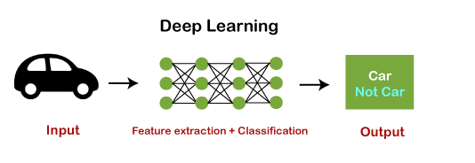
How Deep Learning Works?
By Dr. Luc Ngend

Slide 40
Deep Learning
Please watch this video
https://www.youtube.com/watch?v=6M5VXKLf4D4
By Dr. Luc Ngend

Slide 41
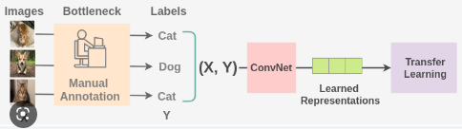
Supervised Learning
By Dr. Luc Ngend

Slide 42
Definition
Supervised learning is the types of machine learning in which machines are trained using well "labelled" training data, and on basis of that data, machines predict the output. The labelled data means some input data is already tagged with the correct output.
In supervised learning, the training data provided to the machines work as the supervisor that teaches the machines to predict the output correctly. It applies the same concept as a student learns in the supervision of the teacher.
By Dr. Luc Ngend

Slide 43
Definition
Supervised learning is a process of providing input data as well as correct output data to the machine learning model. The aim of a supervised learning algorithm is to find a mapping function to map the input variable(x) with the output variable(y).
In the real-world, supervised learning can be used for Risk Assessment, Image classification, Fraud Detection, spam filtering, etc.
By Dr. Luc Ngend

Slide 44
How Supervised Learning Works?
In supervised learning, models are trained using labelled dataset, where the model learns about each type of data. Once the training process is completed, the model is tested on the basis of test data (a subset of the training set), and then it predicts the output.
By Dr. Luc Ngend

Slide 45
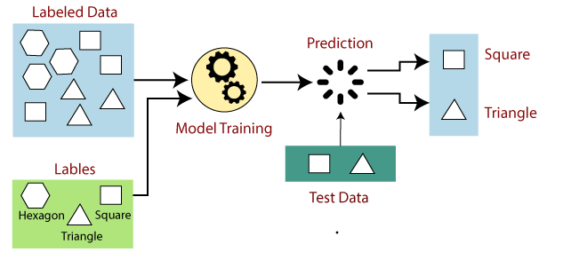
How Supervised Learning Works?
Suppose we have a dataset of different types of shapes which includes square, rectangle, triangle, and Polygon. Now the first step is that we need to train the model for each shape
By Dr. Luc Ngend

Slide 46
How Supervised Learning Works?
If the given shape has four sides, and all the sides are equal, then it will be labelled as a Square.
If the given shape has three sides, then it will be labelled as a triangle.
If the given shape has six equal sides then it will be labelled as hexagon.
Now, after training, we test our model using the test set, and the task of the model is to identify the shape.
The machine is already trained on all types of shapes, and when it finds a new shape, it classifies the shape on the bases of a number of sides, and predicts the output.
By Dr. Luc Ngend

Slide 47
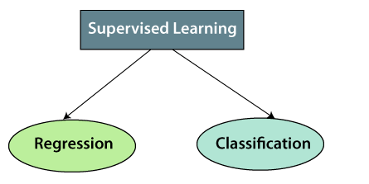
Types of Supervised Learning
Supervised learning can be further divided into two types of problems:
By Dr. Luc Ngend

Slide 48
Classification
Classification algorithms are used when the output variable is categorical, which means there are two classes such as Yes-No, Male-Female, True-false, etc.
Classification algorithms include:
  K-Nearest Neighbor
  Decision Trees
  Random Forest
  Logistic Regression
  Naïve Bayes
  Support Vector Machine
By Dr. Luc Ngend

Slide 49
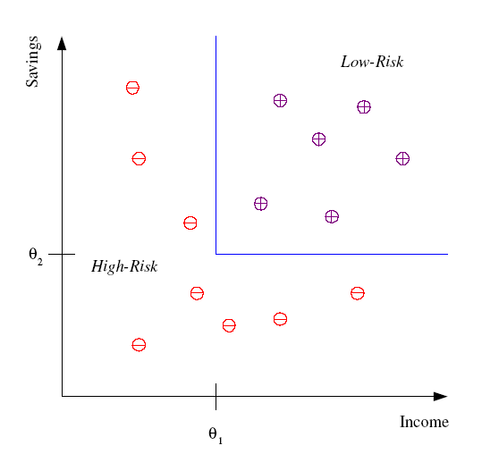
Classification
Example: Credit scoring
Differentiating between low-risk and high-risk customers from their income and savings
Discriminant: IF income > θ₁ AND savings > θ₂
THEN low-risk ELSE high-risk
By Dr. Luc Ngend

Slide 50
Regression
Regression algorithms are used if there is a relationship between the input variable and the output variable. It is used for the prediction of continuous variables, such as Weather forecasting, Market Trends, etc. Below are some popular Regression algorithms which come under supervised learning
Regression algorithms include:
  Linear regression
  Multiple regression
  Bayesian linear regression
  Polynomial regression
By Dr. Luc Ngend

Slide 51
What is the Classification Algorithm?
The Classification algorithm is a Supervised Learning technique that is used to identify the category of new observations on the basis of training data. In Classification, a program learns from the given dataset or observations and then classifies new observation into a number of classes or groups. Such as, Yes or No, 0 or 1, Spam or Not Spam, cat or dog, etc. Classes can be called as targets/labels or categories.
By Dr. Luc Ngend

Slide 52
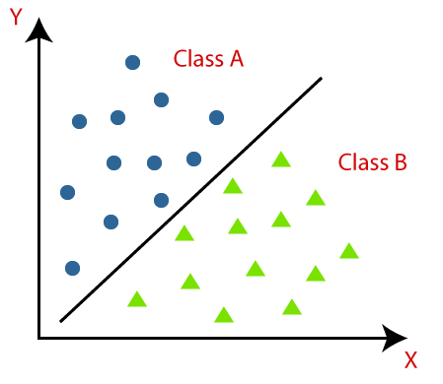
What is the Classification Algorithm?
Classification algorithms can be better understood using this diagram. There are two classes, class A and Class B. These classes have features that are similar to each other and dissimilar to other classes.
By Dr. Luc Ngend

Slide 53
Classifier
The algorithm which implements the classification on a dataset is known as a classifier. There are two types of Classifications:
Binary Classifier: If the classification problem has only two possible outcomes, then it is called as Binary Classifier.
Examples: YES or NO, MALE or FEMALE, SPAM or NOT SPAM, CAT or DOG, etc.
Multi-class Classifier: If a classification problem has more than two outcomes, then it is called as Multi-class Classifier.
Example: Classifications of types of crops, Classification of types of music
By Dr. Luc Ngend

Slide 54
K-Nearest Neighbor (KNN) Algorithm
K-nearest neighbor, also known as the KNN algorithm, is a non-parametric algorithm that classifies data points based on their proximity and association to other available data. This algorithm assumes that similar data points can be found near each other. As a result, it seeks to calculate the distance between data points, usually through Euclidean distance, and then it assigns a category based on the most frequent category or average.
By Dr. Luc Ngend

Slide 55
K-Nearest Neighbor (KNN) Algorithm
Its ease of use and low calculation time make it a preferred algorithm by data scientists, but as the test dataset grows, the processing time lengthens, making it less appealing for classification tasks. KNN is typically used for recommendation engines and image recognition.
By Dr. Luc Ngend

Slide 56
KNN Examples
Please watch the videos below:
https://www.youtube.com/watch?v=IPqZKn_cMts
https://www.youtube.com/watch?v=HZT0lxD5h6k
By Dr. Luc Ngend

Slide 57
Decision Tree Algorithm
A decision tree is a non-parametric supervised learning algorithm, which is utilized for both classification and regression tasks. It has a hierarchical, tree structure, which consists of a root node, branches, internal nodes and leaf nodes.
As an example, let’s imagine that you were trying to assess whether or not you should go surf, you may use the following decision rules to make a choice:
By Dr. Luc Ngend

Slide 58
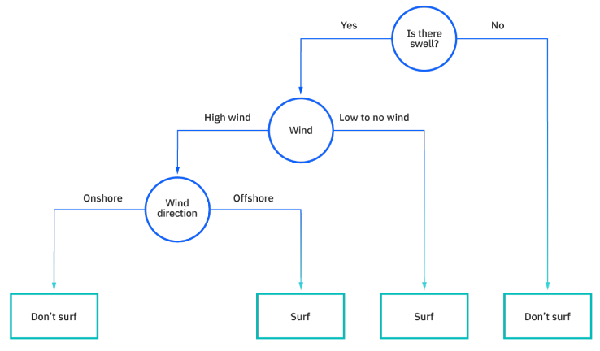
Decision Tree Algorithm
By Dr. Luc Ngend

Slide 59
Example-Decision Tree Algorithm
Please watch the video below
https://www.youtube.com/watch?v=coOTEc-0OGw
By Dr. Luc Ngend

Slide 60
Naive Bayes Algorithm
Naive Bayes is classification approach that adopts the principle of class conditional independence from the Bayes Theorem. This means that the presence of one feature does not impact the presence of another in the probability of a given outcome, and each predictor has an equal effect on that result.
By Dr. Luc Ngend

Slide 61
Naive Bayes Algorithm
Please watch the video below
https://www.youtube.com/watch?v=XzSlEA4ck2I
By Dr. Luc Ngend

Slide 62
Logistic Regression
While linear regression is leveraged when dependent variables are continuous, logistical regression is selected when the dependent variable is categorical, meaning they have binary outputs, such as "true" and "false" or "yes" and "no." While both regression models seek to understand relationships between data inputs, logistic regression is mainly used to solve binary classification problems, such as spam identification.
By Dr. Luc Ngend

Slide 63
Linear Regression
Linear regression is one of the easiest and most popular Machine Learning algorithms. It is a statistical method that is used for predictive analysis. Linear regression makes predictions for continuous/real or numeric variables such as sales, salary, age, product price, etc
Linear regression algorithm shows a linear relationship between a dependent (y) and one or more independent (y) variables, hence called as linear regression. Since linear regression shows the linear relationship, which means it finds how the value of the dependent variable is changing according to the value of the independent variable.
By Dr. Luc Ngend

Slide 64
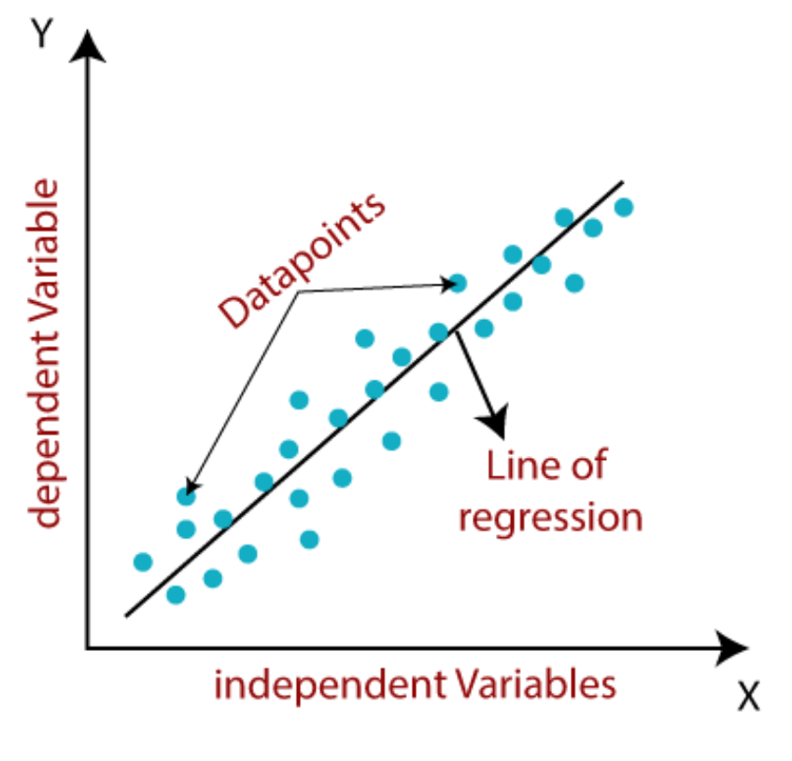
Linear Regression
The linear regression model provides a sloped straight line representing the relationship between the variables. Consider the below image:
By Dr. Luc Ngend

Slide 65
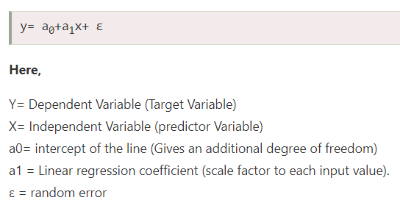
Linear Regression
Mathematically, we can represent a linear regression as:
By Dr. Luc Ngend

Slide 66
Types of Linear Regression
Simple Linear Regression:
If a single independent variable is used to predict the value of a numerical dependent variable, then such a Linear Regression algorithm is called Simple Linear Regression
Multiple Linear regression:
If more than one independent variable is used to predict the value of a numerical dependent variable, then such a Linear Regression algorithm is called Multiple Linear Regression
By Dr. Luc Ngend

Slide 67
Linear Regression Example
Please watch the video below:
https://www.youtube.com/watch?v=OXMATSKUlRY
By Dr. Luc Ngend

Slide 68
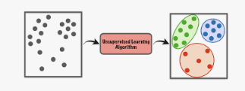
Unsupervised Learning
By Dr. Luc Ngend

Slide 69
Introduction
In the previous topic, we learned supervised machine learning in which models are trained using labeled data under the supervision of training data. But there may be many cases in which we do not have labeled data and need to find the hidden patterns from the given dataset. So, to solve such types of cases in machine learning, we need unsupervised learning techniques.
By Dr. Luc Ngend

Slide 70
What is Unsupervised Learning?
As the name suggests, unsupervised learning is a machine learning technique in which models are not supervised using training dataset. Instead, models itself find the hidden patterns and insights from the given data. It can be compared to learning which takes place in the human brain while learning new things. It can be defined as:
Unsupervised learning is a type of machine learning in which models are trained using unlabeled dataset and are allowed to act on that data without any supervision.
By Dr. Luc Ngend

Slide 71
Example
Suppose the unsupervised learning algorithm is given an input dataset containing images of different types of cats and dogs. The algorithm is never trained upon the given dataset, which means it does not have any idea about the features of the dataset. The task of the unsupervised learning algorithm is to identify the image features on their own. Unsupervised learning algorithm will perform this task by clustering the image dataset into the groups according to similarities between images.
By Dr. Luc Ngend

Slide 72
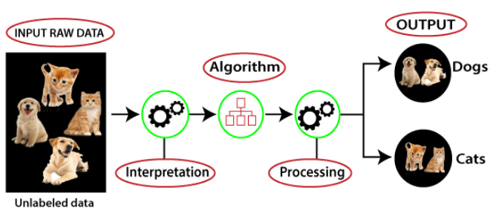
Working of Unsupervised Learning
Working of unsupervised learning can be understood by the below diagram:
By Dr. Luc Ngend

Slide 73
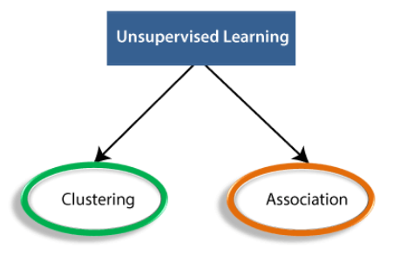
Types of Unsupervised Learning Algorithm:
The unsupervised learning algorithm can be categorized into two types of problems:
By Dr. Luc Ngend

Slide 74
Clustering
Clustering is a method of grouping the objects into clusters such that objects with most similarities remains into a group and has less or no similarities with the objects of another group. Cluster analysis finds the commonalities between the data objects and categorizes them as per the presence and absence of those commonalities.
By Dr. Luc Ngend

Slide 75
Association
An association rule is an unsupervised learning method which is used for finding the relationships between variables in the large database. It determines the set of items that occurs together in the dataset. Association rule makes marketing strategy more effective. Such as people who buy X item (suppose a bread) are also tend to purchase Y (Butter/Jam) item. A typical example of Association rule is Market Basket Analysis.
By Dr. Luc Ngend

Slide 76
Unsupervised Learning Algorithms
Below is the list of some popular unsupervised learning algorithms:
  K-means clustering
  KNN (k-nearest neighbors)
  Hierarchal clustering
  Anomaly detection
  Neural Networks
  Principle Component Analysis
  Independent Component Analysis
  Apriori algorithm
  Singular value decomposition
By Dr. Luc Ngend

Slide 77
A Priori Algorithm
The Apriori algorithm uses frequent itemsets to generate association rules, and it is designed to work on the databases that contain transactions. With the help of these association rule, it determines how strongly or how weakly two objects are connected. This algorithm uses a breadth-first search and Hash Tree to calculate the itemset associations efficiently. It is the iterative process for finding the frequent itemsets from the large dataset.
By Dr. Luc Ngend

Slide 78
What is Frequent Itemset?
Frequent itemsets are those items whose support is greater than the threshold value or user-specified minimum support. It means if A & B are the frequent itemsets together, then individually A and B should also be the frequent itemset.
Suppose there are the two transactions: A= {1,2,3,4,5}, and B= {2,3,7}, in these two transactions, 2 and 3 are the frequent itemsets.
By Dr. Luc Ngend

Slide 79
Example of Apriori Algorithm
Please watch the video below
https://www.youtube.com/watch?v=RDQplhHYUr0
By Dr. Luc Ngend

Slide 80
K-Means Clustering Algorithm
K-Means Clustering is an Unsupervised Learning algorithm, which groups the unlabeled dataset into different clusters. Here K defines the number of pre-defined clusters that need to be created in the process, as if K=2, there will be two clusters, and for K=3, there will be three clusters, and so on.
By Dr. Luc Ngend

Slide 81
K-Means Clustering Algorithm
It is an iterative algorithm that divides the unlabeled dataset into k different clusters in such a way that each dataset belongs only one group that has similar properties
It allows us to cluster the data into different groups and a convenient way to discover the categories of groups in the unlabeled dataset on its own without the need for any training.
By Dr. Luc Ngend

Slide 82
K-Means Clustering Algorithm
It is a centroid-based algorithm, where each cluster is associated with a centroid. The main aim of this algorithm is to minimize the sum of distances between the data point and their corresponding clusters.
By Dr. Luc Ngend

Slide 83
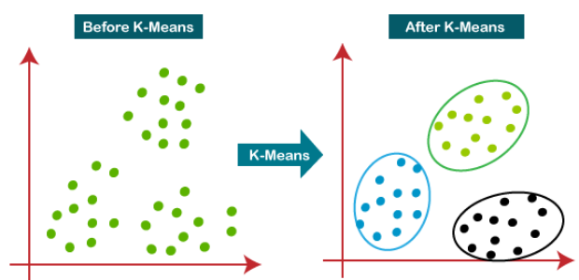
K-Means Clustering Algorithm
The below diagram explains the working of the K-means Clustering Algorithm
By Dr. Luc Ngend

Slide 84
K-Means Clustering Example
Please watch the following videos
https://www.youtube.com/watch?v=_S5tvagaQRU
By Dr. Luc Ngend

Slide 85
Neural Networks
Neural networks, also known as artificial neural networks (ANNs) or simulated neural networks (SNNs), are a subset of machine learning and are at the heart of deep learning algorithms. Their name and structure are inspired by the human brain, mimicking the way that biological neurons signal to one another.
By Dr. Luc Ngend

Slide 86
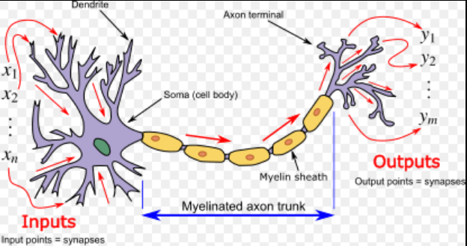
Biological Neuron
By Dr. Luc Ngend

Slide 87
Neural Networks
Artificial neural networks (ANNs) are comprised of a node layers, containing an input layer, one or more hidden layers, and an output layer. Each node, or artificial neuron, connects to another and has an associated weight and threshold. If the output of any individual node is above the specified threshold value, that node is activated, sending data to the next layer of the network. Otherwise, no data is passed along to the next layer of the network.
By Dr. Luc Ngend

Slide 88
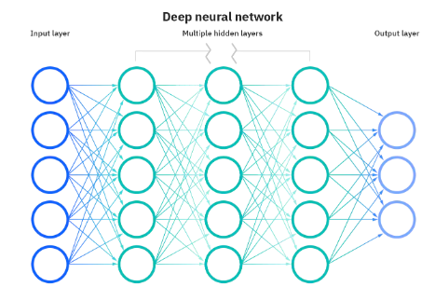
Deep Neural Nets
When there are many hidden layers the neural net becomes a deep neural net (used in deep learning)
By Dr. Luc Ngend

Slide 89
Neural Nets in 5 min
Please watch this video
https://www.youtube.com/watch?v=bfmFfD2RIcg
By Dr. Luc Ngend

Slide 90
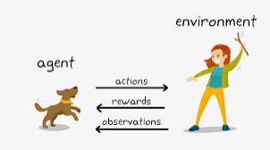
Reinforcement Learning
By Dr. Luc Ngend

Slide 91
What is Reinforcement Learning?
Reinforcement Learning is a feedback-based Machine learning technique in which an agent learns to behave in an environment by performing the actions and seeing the results of actions. For each good action, the agent gets positive feedback, and for each bad action, the agent gets negative feedback or penalty.
By Dr. Luc Ngend

Slide 92
What is Reinforcement Learning?
The agent learns with the process of hit and trial, and based on the experience, it learns to perform the task in a better way. Hence, we can say that "Reinforcement learning is a type of machine learning method where an intelligent agent (computer program) interacts with the environment and learns to act within that." How a Robotic dog learns the movement of his arms is an example of Reinforcement learning.
By Dr. Luc Ngend

Slide 93
How RL Works
Suppose there is an AI agent present within a maze environment, and his goal is to find the diamond. The agent interacts with the environment by performing some actions, and based on those actions, the state of the agent gets changed, and it also receives a reward or penalty as feedback.
By Dr. Luc Ngend

Slide 94
How RL Works
The agent continues doing these three things (take action, change state/remain in the same state, and get feedback), and by doing these actions, he learns and explores the environment.
The agent learns what actions lead to positive feedback or rewards and what actions lead to negative feedback penalty. As a positive reward, the agent gets a positive point, and as a penalty, it gets a negative point.
By Dr. Luc Ngend

Slide 95
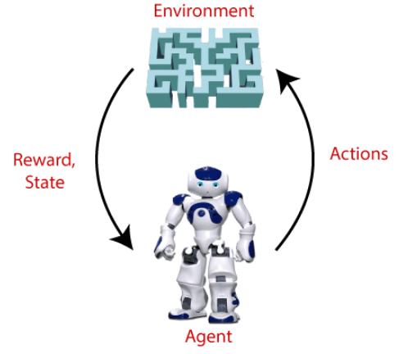
How RL Works
By Dr. Luc Ngend

Slide 96
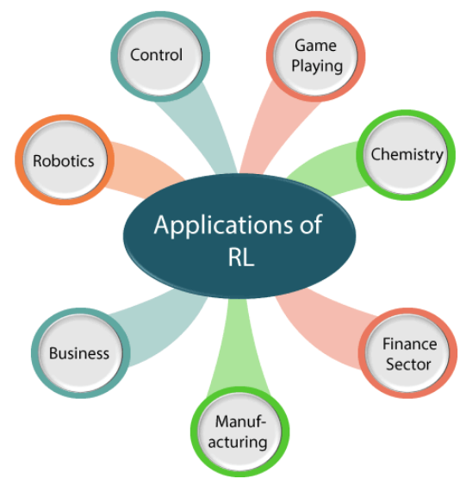
RL Applications
By Dr. Luc Ngend

Slide 97
A Policy in RL
Policy: A policy can be defined as a way how an agent behaves at a given time. It maps the perceived states of the environment to the actions taken on those states. A policy is the core element of the RL as it alone can define the behavior of the agent.
By Dr. Luc Ngend

Slide 98
RL Algorithms
Q-Learning
State Action Reward State Action (SARSA)
Deep Q Neural Network (DQN)
Monte Carlo
By Dr. Luc Ngend

Slide 99
Q-Learning
Q-Learning: Q-learning is an Off policy RL algorithm, which is used for the temporal difference Learning. The temporal difference learning methods are the way of comparing temporally successive predictions.
It learns the value function Q (S, a), which means how good to take action "a" at a particular state "s.
By Dr. Luc Ngend

Slide 100
Q-Learning Algorithm
Please watch the video below:
https://www.youtube.com/watch?v=_O9a5xbBe-s
By Dr. Luc Ngend

